Slide 1
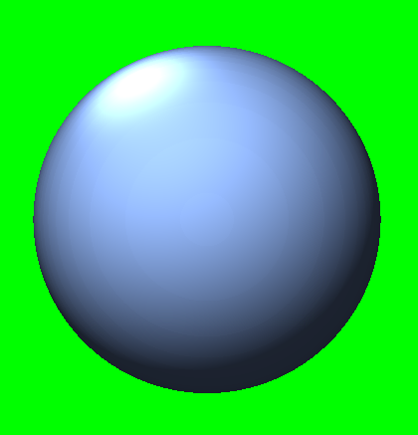
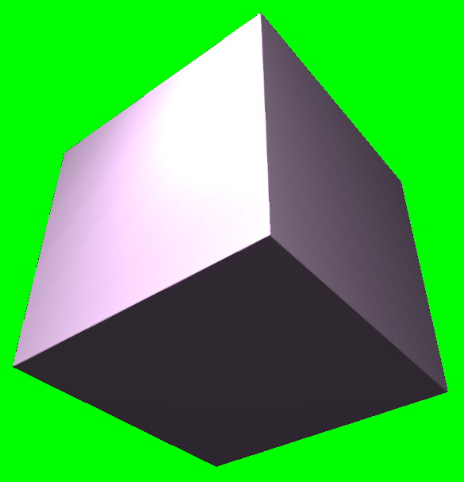
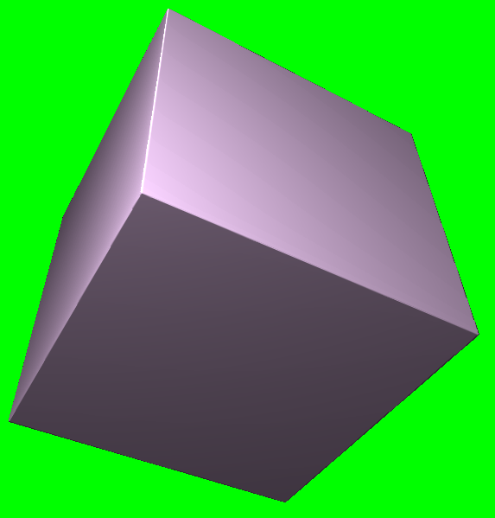
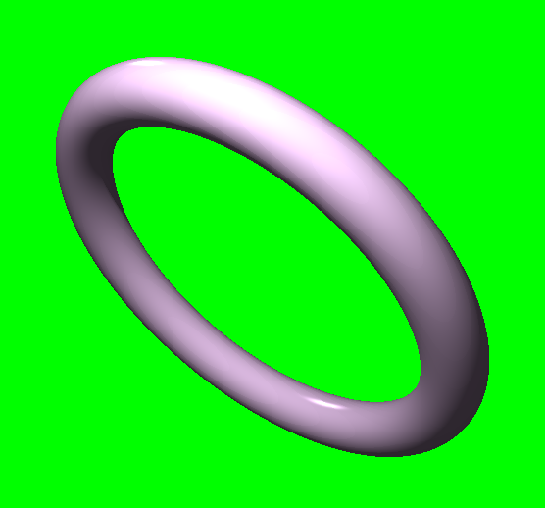
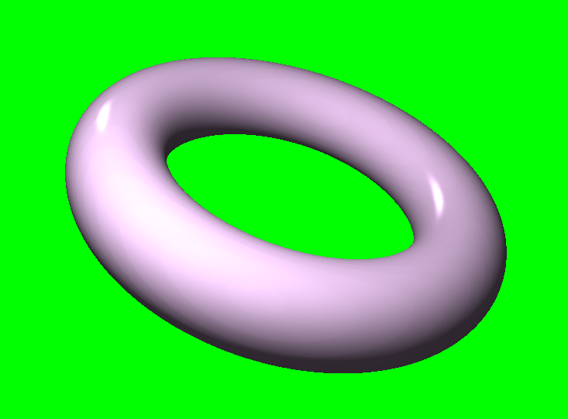
Utilising ray marching and signed- distance functions to render a scene of primitives
Anthony Sturdy
18015368
BSc (Hons) Computer Games Programming
Dr. David White & Craig Weightman

Slide 2
INTRODUCTION
Use of ray tracing recently brought to the forefront of real-time rendering.
Ray marching shares many similarities to ray tracing.
Differences:
Shapes defined by maths.
Method of finding intersection.

Slide 3
AIM & OBJECTIVES
This research aims to explore the areas needed to produce a rendering engine that utilises ray marching as a method of rendering a 3D scene and to take advantage of the characteristics of ray marching to achieve various visual effects.
OBJECTIVE 1
Develop performant, real-time ray marching renderer.
OBJECTIVE 2
Implement rendering effects only viable in real-time with ray marching.
OBJECTIVE 3
Various visual effects typically associated with ray-based rendering.
OBJECTIVE 4
An engine framework surrounding the renderer, providing a graphical user interface for users to control objects within the scene.

Slide 4
BACKGROUND
Ray-based rendering is computationally expensive compared to other traditional rendering techniques such as rasterisatiton. Ensuring the project remains performant, and real-time, would prove the biggest challenge for this project.
Allow user to add/remove/modify objects.
Allow for custom object shapes (SDFs).
Provide a variety of visual effects.
Avoid limiting the user.

Slide 5
RESEARCH METHODOLOGY
WATERFALL Linear Prevents scope becoming out-of-proportion KANBAN Flexible Allows for iteration and simultaneous feature development SCRUM Keeps team aligned Promotes iterative development SCRUMBAN Combines advantages of Scrum and Kanban Short sprints provide flexibility | The methodology chosen for this project is Kanban, for the flexibility offered with the ability to research and develop tasks simultaneously. Waterfall was too restrictive due to the linearity of the methodology. Scrum is most-effective when used in a team. Scrumban would also be unsuitable as it is most-effective when used in a team.

Slide 6
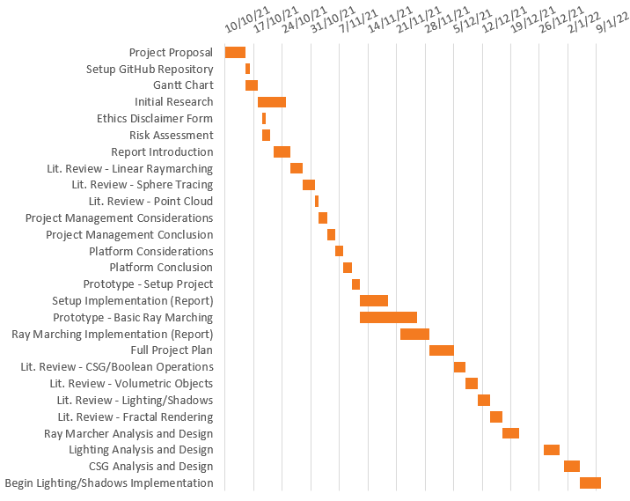
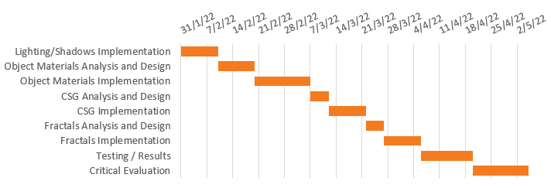
PROJECT PLAN
Gantt chart was used to plan the time taken for each feature.
Some features were able to be researched and/or developed simultaneously.
Towards the end of the project, larger features or report sections were allotted more time.

Slide 7











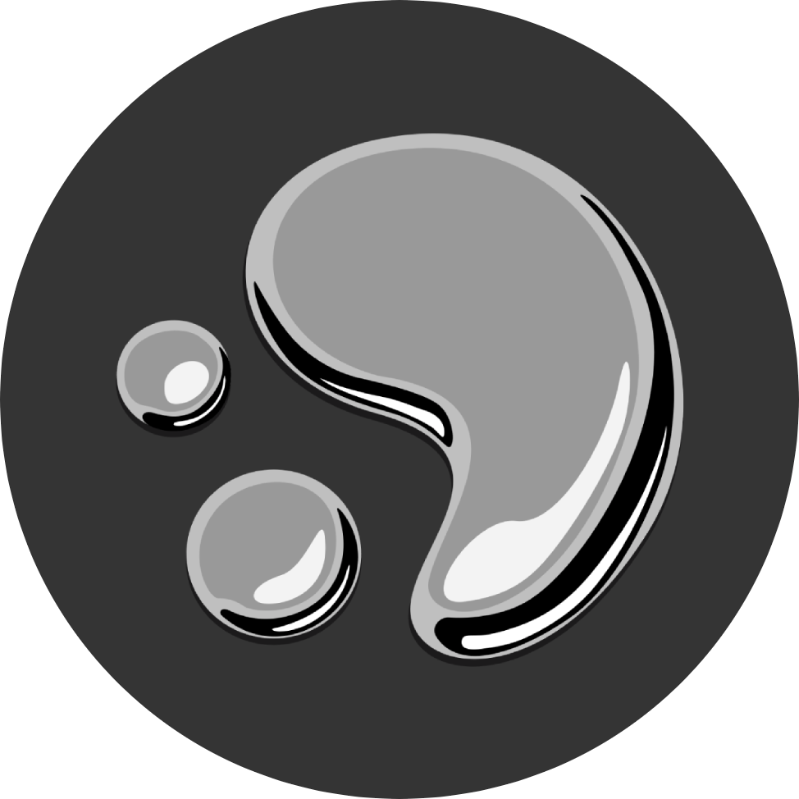
ANALYSIS
PLATFORM
Unity, DirectX 11, Vulkan
PLANNING
Trello, Microsoft Planner, GitHub Projects
IDE
Visual Studio 2022, CLion, Code::Blocks
VERSION CONTROL
Git, Subversion (SVN), Mercurial

Slide 8
DESIGN
PLATFORM
DirectX 11 was used for the development platform for this project.
PLANNING
The Kanban board was created and managed using Trello.
IDE
Visual Studio 2022 was the chosen IDE used to develop the project.
VERSION CONTROL
Git was used for version control, paired with GitHub to host the Git repository.
OTHER
C++
ImGui
DirectXTK

Slide 9
IMPLEMENTATION

Slide 13
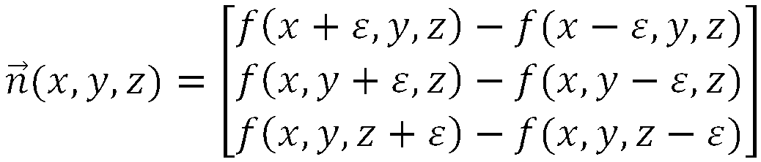
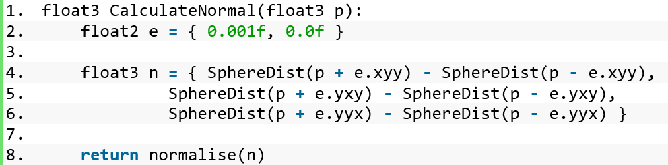
Distance to scene
Both equate to: p + float3(0.001,0,0)
Both equate to: p + float3(0,0.001,0)

Slide 14
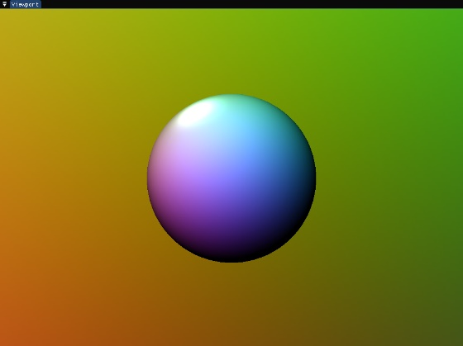




$$A=K_{a}C_{a}$$
$$D=\sum_{i ∈ lights}{(K_{d}\left(L_{i}∙N\right)C_{i,d})}$$
$$S=\sum_{i ∈ lights}{(K_{s}{\left(V∙R\right)}^{e}C_{i,s})}$$
$$L_{p}=(A+D+S)C_{p}$$

Slide 15
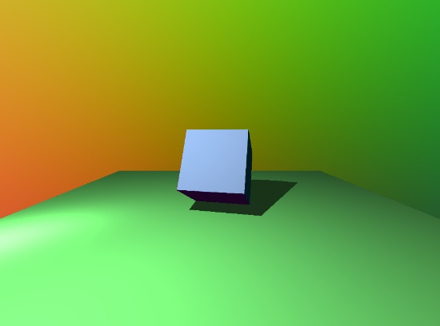
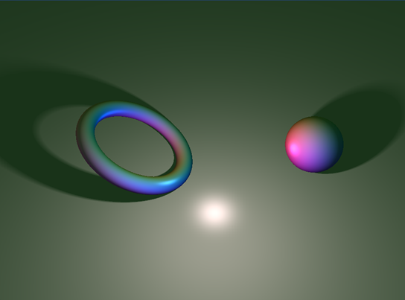

$$r=p∗d÷t$$
Total shadow value
Penumbra strength
Distance from scene
Distance ray has travelled

Slide 16

The way to get started is to quit talking and begin doing.
Walt Disney

Slide 17
Team
Name Title
Name Title
Name Title
Name Title

Slide 18
Timeline
Title
To start a presentation, go to the Slide Show tab, and select From Beginning.
Title
To display Presenter view, in Slide Show view, on the control bar at the bottom left select the three dots, and then Show Presenter View.
Title
During your presentation, the speaker notes are visible on your monitor, but aren't visible to the audience.
Title
The Notes pane is a box that appears below each slide. Tap it to add notes.
Title
If you don’t see the Notes pane or it is completely minimized, click Notes on the task bar across the bottom of the PowerPoint window.

Slide 19
Title
Subtitle
Subtitle
Add text, images, art, and videos.
Add transitions, animations, and motion.
Save to OneDrive, to get to your presentations from your computer, tablet, or phone.
Open the Design Ideas pane for instant slide makeovers.
When we have design ideas, we’ll show them to you right there.

Slide 20
Title
Subtitle
Subtitle
Subtitle
Add text, images, art, and videos.
Add transitions, animations, and motion.
Save to OneDrive, to get to your presentations from your computer, tablet, or phone.
Open the Design Ideas pane for instant slide makeovers.
When we have design ideas, we’ll show them to you right there.
This PowerPoint theme uses its own unique set of colors, fonts, and effects to create the overall look and feel of these slides.
PowerPoint has tons of themes to give your presentation just the right personality.

Slide 21



Summary
With PowerPoint, you can create presentations and share your work with others, wherever they are. Type the text you want here to get started. You can also add images, art, and videos on this template. Save to OneDrive and access your presentations from your computer, tablet, or phone.

Slide 22




Thank you
Presenter name
Email address
Website

